Slide 1

Course: Electronic Engineering UEC001
Topic: Sequential Circuits

Slide 2
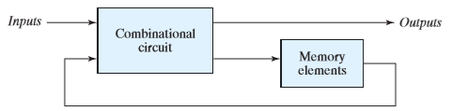
Sequential Circuits
The sequential logic is a type of logic circuit whose output depends not only on the present value of its input signals but on the sequence of past inputs, the input history as well.
Memory elements are required.
Feedback path is present.
Slight difficult to design if compared to Combinational Circuit .
Clock signal is required.
Asynchronous sequential circuits
Synchronous sequential circuits
Examples of common sequential logic circuits include: Flip flop, registers and counters.

Slide 3
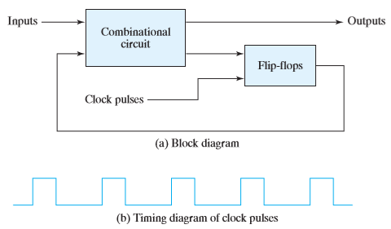
Synchronous clocked sequential circuit

Slide 4
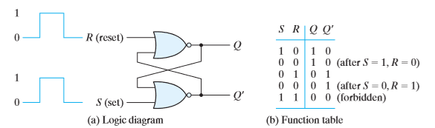
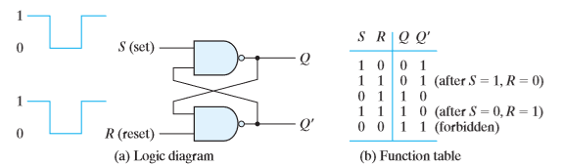
SR Latch

Slide 5
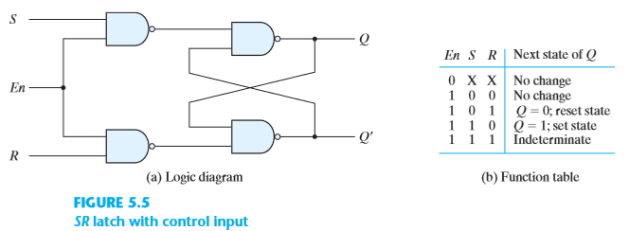
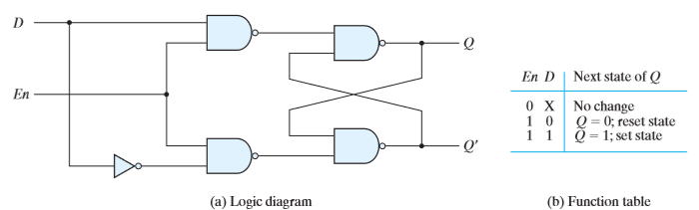
SR latch with control input
D Latch (Transparent Latch)

Slide 6
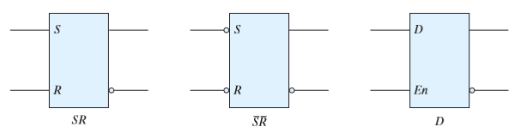
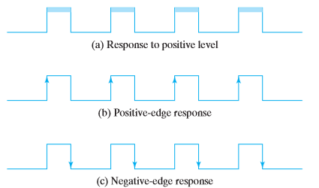
Graphic symbols for latches
STORAGE ELEMENTS: FLIP-FLOPS
Clock response in latch and flip-flop

Slide 7
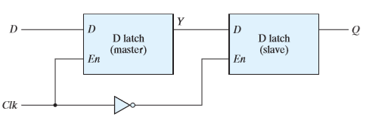
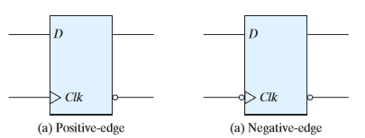
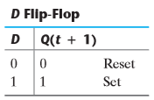
Edge-Triggered D Flip-Flop
Graphic symbol for edge-triggered D flip-flop
Q(t + 1) = D

Slide 8
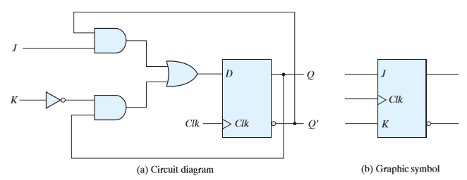
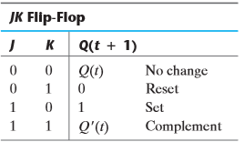


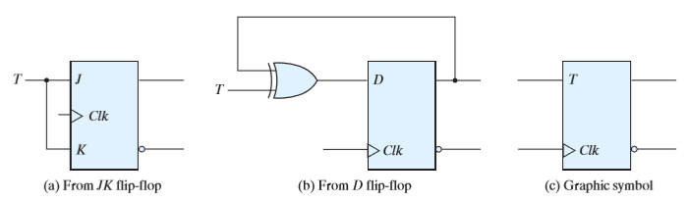
JK flip-flop
T flip-flop

Slide 9
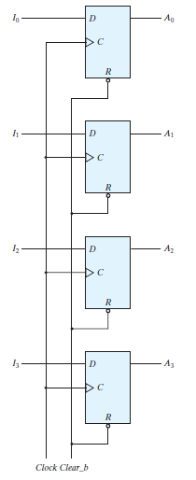
REGISTERS
A register is a group of flip‐flops, each one of which shares a common clock and is
capable of storing one bit of information.
An n ‐bit register consists of a group of n flip‐flops capable of storing n bits of binary information.

Slide 10
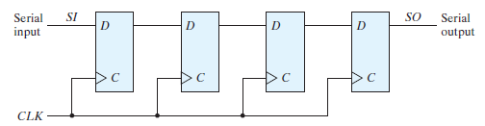
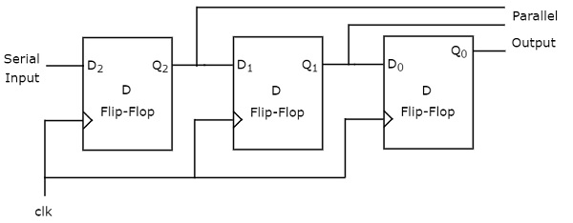
Shift Registers
Serial In − Serial Out
Serial In − Parallel Out

Slide 11
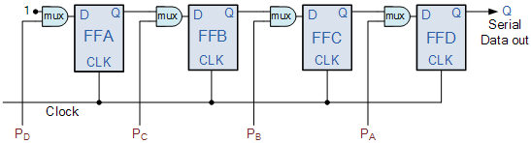
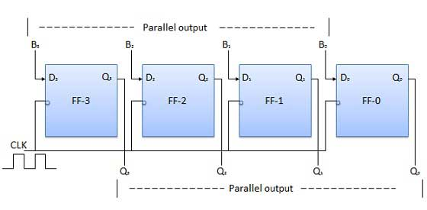
Shift Registers
Parallel In − Serial Out
Parallel In − Parallel Out

Slide 12
Counters
Notes:
12

Slide 13
Counters
Counters are sequential networks and are constructed from one or more flip-flops that change state in a prescribed sequence when input pulses are received.
A Counter driven by a clock can be used to count the number of clock cycles. Since the clock pulses occur at known intervals, the counter can be used as an instrument for measuring time and therefore period of frequency.
Counters can be broadly classified into following categories:
(i) Asynchronous Counters and Synchronous Counters.
(ii) Single and multi-mode Counters.
(iii) Modulus counters.
Notes:
13

Slide 14
Types of Counters
Asynchronous Counters
Asynchronous counter is simple in operation and construction and usually requires a minimum amount of hardware.
Each flip flop is triggered by the previous flip-flop, and hence the speed of operation is limited.
Settling time of these counters is the cumulative sum of the individual settling times of the flip-flops. This type of counters is also called Ripple or Serial counter.
Synchronous Counters
Speed limitation of asynchronous counters is overcome by applying clock pulses simultaneously to all of the flip-flops.
Settling time of the Synchronous counter is equal to the propagation delay of a single flip-flop.
Increase in speed is usually attained at the price of increased hardware. This type of counter is also known as a Parallel counter.
Notes:
14

Slide 15
Types of Counters
Single Mode Counter
If contents of the counters advance by one with each clock pulse; it is said to operate in the Count-up mode.
The opposite is also possible i.e. If contents of the counters decrease by one with each clock pulse, the counter is said to operate in the Count-down mode. Such counters are called single mode counter.
Multi-mode Counter
If a counter circuit operates in both the UP and DOWN modes, it is called a multi-mode counters.
Modulus Counters
These counters are defined based on the number of states they are capable of counting. There are two types of these counters:-
MOD N: if there are n bits then the maximum number counted can be 2^{n} or N. If the counter counts up to 2^{n} or N states, it is called MOD N or MOD 2^{n} Counter.
MOD < N: if the counter is designed to count sequences less than the maximum value attainable, it is called a MOD < N or MOD < 2^{n} counter.
Notes:
15

Slide 16
Asynchronous Counter
Notes:
16

Slide 17
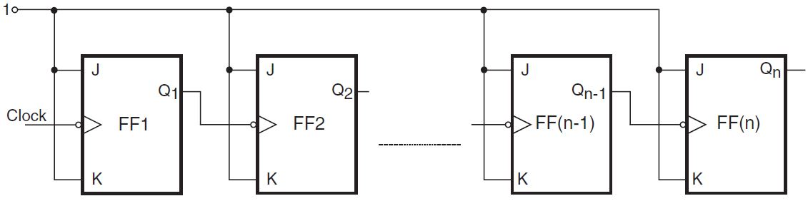
Asynchronous (Ripple) Counter
A Ripple Counter is a cascaded arrangement of flip-flops where the output of one flip-flop drives the clock input of the following flip-flop.
Number of flip-flops in the cascaded arrangement depends upon the number of different logic states that it goes through before it repeats the sequence, a parameter known as the modulus of the counter.
Clock input to Ripple Counter, primary clock signal is applied only to the first flip-flop, which is called the input flip-flop, in the cascaded arrangement.
Clock to subsequent flip-flop comes from the output of its immediately preceding flip-flop. Thus output of the first flip-flop acts as the clock input to the second flip-flop, and so on.
A generalized block schematic arrangement of an n-bit binary ripple counter is shown below.
Notes:
17

Slide 18
Asynchronous (Ripple) Counter
In a Ripple Counter, all flip-flops do not change state at the same time. A flip-flop changes its state only after the preceding flip-flop changes its state.
2nd flip-flop changes its state after a certain time delay i.e. after the occurrence of the input clock pulse, as its own clock input is from the output of the first flip-flop and not from the input clock. This time delay equals the sum of propagation delays of two flip-flops, the 1st and 2nd flip-flops.
Thus, the n^{th} flip-flop will change state only after a delay equal to 'n' times the propagation delay of one flip-flop.
Term ‘Ripple Counter’ gets its name from the mode in which the clock information ripples through the counter. It is also called ‘Asynchronous counter’ as different flip-flops of the counter do not change state in synchronization with the input clock.
In a Ripple Counter, after the occurrence of each clock input pulse, the counter has to wait for a time period equal to the sum of propagation delays of all flip-flops before the next clock pulse can be applied.
Notes:
18

Slide 19
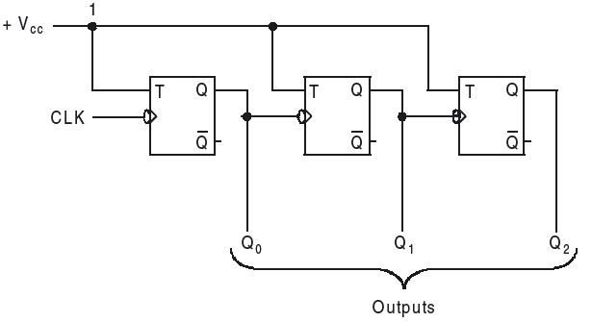
Asynchronous (Ripple) Up Counter
A 3-bit counter capable of counting from 0 to 7 is shown below. The clock inputs of the three flip-flops are connected in cascaded manner.
The T input of each flip-flop is connected to a constant 1, which means that the state of the flip-flop toggles (reverses) at each negative edge of its clock.
This counter counts the number of pulses that occur on the primary input called CLK (Clock).
The other two flip-flops have their clock inputs driven by the Q output of the preceding flip-flop. Therefore, they toggle their state when the preceding flip-flop changes its state from Q=1 to Q=0, i.e. on negative edge of the Q signal.
Q: How will you use other flip flops in toggle mode?
Notes:
19

Slide 20
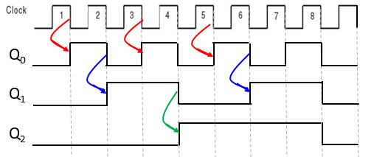
Asynchronous (Ripple) Up Counter
Timing diagram for the counter is shown below.
Q₀ toggles once each clock cycle. Change takes place shortly after the negative edge of the Clock signal. Delay is due to the propagation delay of the flip-flop.
Second flip-flop is clocked by Q₀, the value of Q₁ changes shortly after the negative edge of the Q₀ signal. Similarly Q₂ changes shortly after the negative edge of the Q1 signal.
States of Q₂ Q₁ Q₀ indicate the counting sequence to be 0, 1, 2, 3, 4, 5, 6, 7, 0, 1, 2, and so on. Thus the circuit is a modulo-8 counter and it counts in the upward direction.
Notes:
20

Slide 21
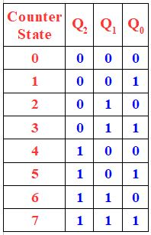
Asynchronous (Ripple) Up Counter
Counter shown below has three stages, each comprising of a single flip-flop. First stage responds directly to the Clock signal. Next 2 stages respond after an additional delay.
When counter changes from 3 to 4 on arrival of next clock pulse, all three flip-flops toggle their states. The change in Q₀ is observed only after a propagation delay from the negative edge of the primary clock pulse. Change in Q₁ and Q₂ flip-flops takes place after a brief period, in the interim period the count changes from (for Q₂Q₁Q₀) 011→ 010 → 000 → , before settling at 100. (Glitch Creation)
Table shows the sequence of binary states. An ‘n’ bit counter has 2^{n} states (from 0 to 2^{n}-1).
0
0
0
1
0
0
0
1
0
1
1
0
0
0
1
1
0
1
0
1
1
1
1
1
0 1 2 3 4 5 6 7
Notes:
21

Slide 22
Asynchronous Counter (As Frequency Divider)
Assume f be the clock frequency for the Counter.
Since, output Q₀ changes only when the clock makes a transition from 1 to 0. Thus, at the first negative transition, Q₀ changes from 0 to 1, and with the second negative transition of the clock Q₀ shifts from 1 to 0.
Hence, two input pulses will result in a single pulse in Q₀. Hence the frequency of Q₀ will be f/2.
Similarly, the frequency of Q₁ signal will be half that of Q₀ signal. Therefore its frequency is f/4.
Similarly, the frequency of Q₂ will be f/8.
Hence the circuit is also called a Frequency Divider as divides the input frequency. If there are n flip-flops used in the circuit then the frequency will be divided by 2^{n}.
Notes:
22

Slide 23
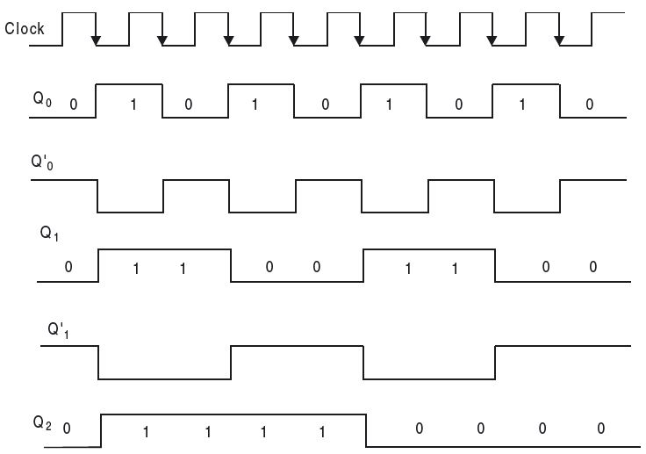
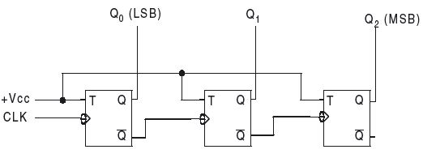
Asynchronous (or Ripple) Down-counter
Standard Ripple Counter circuit is modified so that the clock inputs of the second, third, and subsequent flip-flops are driven by the Q′ outputs of the preceding stages, rather than by the Q outputs.
If the initial counter content is 000, at the first negative transition of the clock, the counter content changes to 111; at the second negative transition, the content becomes 110; at the third negative transition of clock, the content changes to 101, and so on. Thus, in the down-counter, the counter content is decremented by one for every negative transition of the clock pulse.
Q₀
Q₀’
Q₁
Q₁’
Q₂
Notes:
23

Slide 24
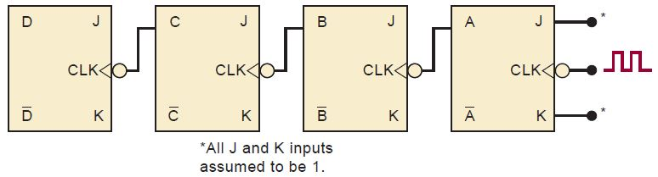
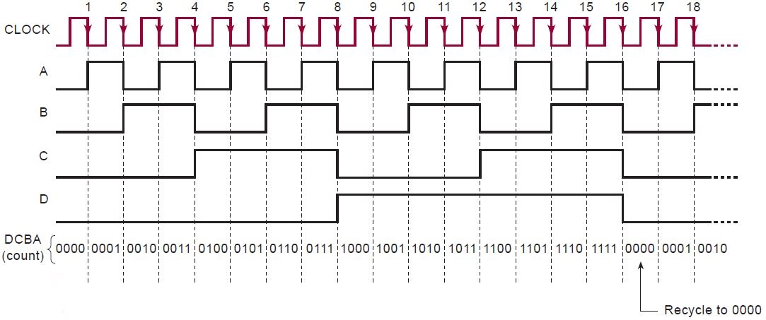
Ripple Counter with JK Flip Flop
-1
-1
-1
1
D F/F
C F/F
B F/F
A F/F
-1
-1
-1
1
Notes:
24

Slide 25
Modulus or MOD of a Counter
Counter shown in the previous slides had three flip flops and could count from 000 to 111 (0 to 7) i.e. the counter had total 8 distinct states.
Such a counter, that has total 8-states, is called a MOD-8 asynchronous counter.
The Modulus (or MOD-number) of a counter is the total number of unique states it passes through in each of the complete cycles.
Modulus = 2^{n}
where n = Number of flip-flops.
Biggest binary number that can be counted by the counter is 2^{n} –1.
Hence, a 3-flip-flop counter can count a maximum of
(111)₂ = 2³ – 1 = 7₁₀
Notes:
25

Slide 26
Steps to Construct a MOD-N Counter
Following general steps are to be followed:-
Find the number of flip-flops (n) required for the desired MOD-number using the equation
2^{n-1} < N < 2^{n} (or 2^{n-1} + 1 ≤ N < 2^{n} ),
where N is the total states to be counted.
For n=3 i.e. with 3 flips flops we can count from 5 to 8 states
Connect all the n flip-flops as a Ripple Counter.
Find the binary number for N.
Connect all the flip-flop outputs, for which Q = 1 or Q′ = 1, when the count is N, as inputs to the NAND gate.
Connect the NAND gate output to the clear input of each flip-flop.
When the counter reaches the N^{th} state, the output of the NAND gate goes low, resetting all flip-flops to 0. So the counter counts from 0 through N – 1, having N states.
Notes:
26

Slide 27
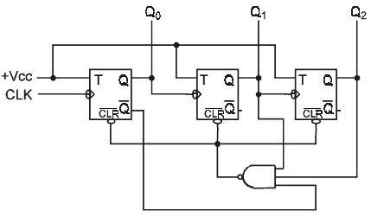
Asynchronous (or Ripple) Counter With Modulus < 2^{n}
Ripple counter with n is the number of flip-flops is a MOD-N or MOD 2^{n} counter, where and N is the number of count sequences/states. This is the maximum MOD-number that is attainable by using n flip-flops.
To have a counter with MOD-number < 2^{n}, it is required to skip states that are normally a part of the counting sequences.
A MOD-6 ripple counter shown below uses 3-flip flops, which without the NAND gate would be a MOD-8 binary ripple counter, which can count from 000 to 111. However, with a NAND gate, the sequence is altered:-
Notes:
27

Slide 28
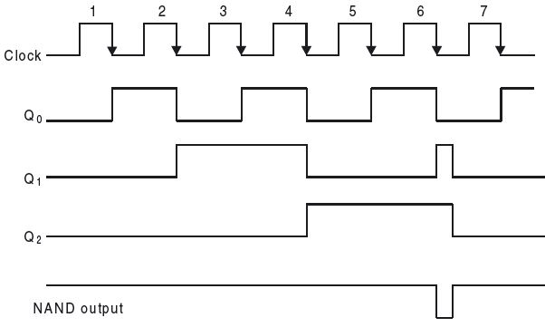
Asynchronous (or Ripple) Counter With Modulus < 2^{n}
NAND gate output is connected to the clear inputs of each flip-flop. As along as the NAND gate output remains high, it will have no effect on the counter.
As soon as NAND gate output goes low, it clears all flip-flops to the 000 state.
Outputs Q₂ , Q₁ , and Q′₀ are given as the inputs to the NAND gate to detect the counter state Q₂Q₁Q₀ = 110. This happens at the sixth clock pulse, the low output of NAND gate clears the counter to 000 state and the NAND gate output goes back to 1.
The counting cycle of the required counting sequence begins again.
0
1
1
Notes:
28

Slide 29
Asynchronous (or Ripple) Counter With Modulus < 2^{n}
When the 6th clock pulse occurs, counter briefly goes to the 110 state, it remains there only for a few nanoseconds, as it is reset to the 000 state by the NAND gate. Thus the counter counts from 000 to 101 and skips the states 110 and 111.
From the waveform shown below, the Q1 output contains a spike or glitch caused by the momentary occurrence of the 110 state before the counter is cleared to 000 state. The glitch is very narrow (owing to the propagation delay of the NAND gate).
The Q2 output has a frequency equal to 1/6 of the input frequency, as this counter counts from 0 to 5 (Total 6 states).
Notes:
29

Slide 30
Synchronous Counter
Notes:
30

Slide 31
Synchronous Counter
Ripple or Asynchronous counter is the simplest to build, but it has following limitations
its highest operating frequency is limited because of ripple action. Since each flip-flop has a delay time and delay times are additive and the total “settling” time for the counter is approximately the product of the delay time of a single flip-flop and the total number of flip-flops.
there is the possibility of glitches occurring at the output of decoding gates used with a ripple counter.
Synchronous counters overcome above mentioned problems, as all flip flops are simultaneously clocked in synchronism with the input clock signal.
Synchronous counters can be designed for any count sequence (need not be straight binary) following a systematic approach.
Delay involved is equal to the propagation delay of one flip-flop only, irrespective of the number of flip-flops used to construct the counter.
Delay is independent of the size of the counter.
Notes:
31

Slide 32
Design Procedure of a Synchronous Counter
Following steps are to be followed for designing a Synchronous Counter of any given count sequence and modulus:
Step 1. From the given word description of the problem, draw a state diagram that describes the operation of the counter.
Step 2. From the state diagram, write the count sequences in the form of a table. This table is called State Table.
Step 3. Find the number of flip-flops required for achieving the desired states.
Step 4. Decide the type of flip-flop to be used for the design of the counter. Then determine the flip-flop inputs that must be present for the desired next state from the present state using the excitation table of the flip-flops.
Step 5. Prepare K-maps for each input of all the flip-flops in terms of flip-flop outputs as the input variables. Simplify the K-maps and obtain the minimized expressions.
Step 6. Draw the logic circuit using flip-flops and other gates corresponding to the minimized expressions.

Slide 33
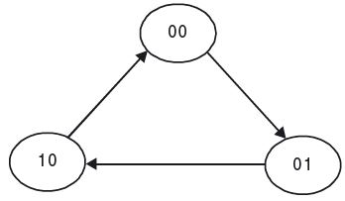
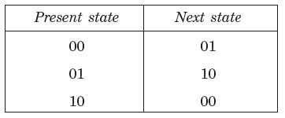
Design of a MOD-3 Counter
A MOD-3 counter has only three distinct states. Number of flip flops required to design a counter with 3 states is found from the equation 2^{n-1} + 1 ≤ N < 2^{n} , where n is the number of flip-flops required and N is the number of states present in the counter.
For N = 3, Number if flip flops n = 2, i.e., two flip-flops are required.
Draw the State Diagram shown below. State transition from one state to another takes place only when a clock transition takes place. From the state diagram, form the State Table for the counter as shown.
State Diagram
State Table

Slide 34
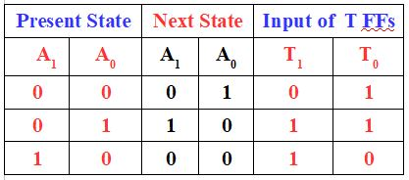
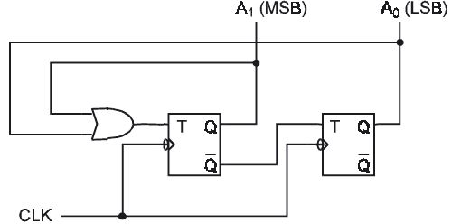
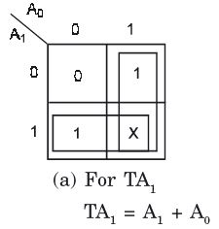
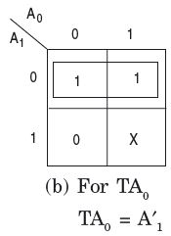
Design of a MOD-3 Counter
Using the State Table and the Excitation table of the flip-flops, prepare the Excitation Table for the MOD-3 counter as shown below. Any one of the four flip-flops types (S-R, J-K, T, and D) can be used. For simplicity, T flip-flop is used here. Since MOD-3 counter requires two FFs, two in number T Flip flops with present states as A₁ & A₀ are used. The next states of theses flip flops are designated as A₁⁺ & A₀⁺ .
Flip-flop input functions T1 & T2 are derived from the counter excitation table using K-maps as shown below. Boolean functions specify the combinational circuit part of the counter. The required logic diagram of the counter is as shown:-
+
+

Slide 35
Lock Out
In the counters with modulus less than 2^{n}, counter by chance may find itself in any one of the unused states. For example, in the MOD-10 counter, logic states, A₃A₂A₁A₀ = 1010, 1011, 1100, 1101, 1110, and 1111 are not used.
Now, if by chance the counter enters into any one of these unused states and its next state is not known, then it may be possible that the counter might go from one unused state to another and never return back to used state. In such a situation the counter becomes useless for its intended purpose.
A counter whose unused states have this feature is said to suffer from lock out.
To make sure that at the starting point, the counter is in its initial state or it comes to its initial state within a few clock cycles (count error due to noise), external logic circuitry is provided. To ensure that lock out does not occur, counter is designed assuming the next state to be the initial state or any known valid state, from each of the unused states.

